Slide 1
[
Welcome To Our
ABC MARKETING CO.
Beta Program
Reputation Marketing & Expert Interview Overview

Slide 2
Todays
Expose Interview Meeting
R
P
I
Reputation Marketing
Script Details
Expert Interview
Overview On How To Leverage A 5 Star Reputation To Get Customers
Get The Resources We Need To Produce Your Interview
Step By Step Through Understanding How To Leverage Your Interview

Slide 3
Question?
Three Services Are Virtually Identical
Service
Service
Service
A
B
C
Four Good Reviews Two Bad Reviews
No Reviews
Six 5 Star Reviews
Which One Would You Choose To Buy?

Slide 4
Do Consumers Trust Your Business?
Without 6 Five Star Reviews… Your Business Isn’t Trusted Online
10
6-10
REVIEWS
REVIEWS
How Many Reviews Does A Consumer Look Up Before Making A Decision?
How Many Reviews Does A Business Need Before A Consumer Can Trust Them?

Slide 5
“Reputation Marketing” Is The Most Effective Way To Market…
What’s Your Experience With Reputation Management?
You Don’t Make Money Managing…
Reputation Management Is Obsolete…
Smart Businesses Start With Reputation
You Make Money Marketing

Slide 6
The Game Of Online Marketing Just Changed…
To Give 5 Star Companies The Advantage

Slide 7
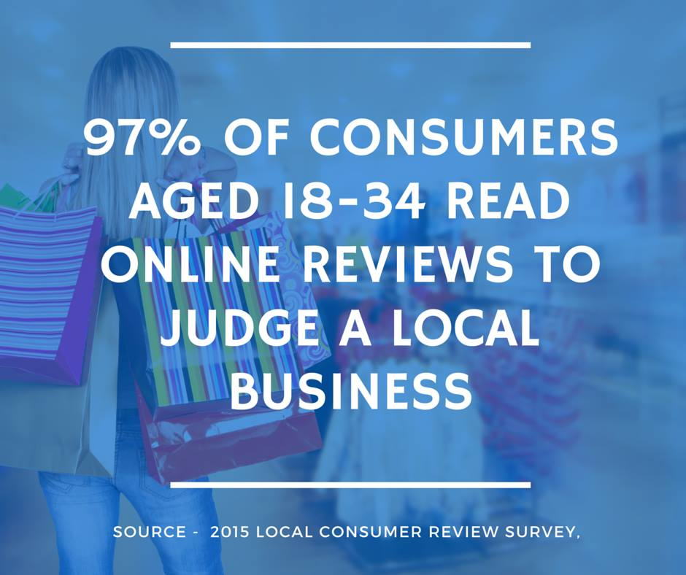

Slide 8
Q: If you were searching for a business… WHO WOULD YOUR CALL FIRST?
Most respondents would first call “The business that had excellent 5 star reviews and a great reputation” Because “BUYERS” Are Looking For the “Most Reputable” company to do business with.

Slide 9
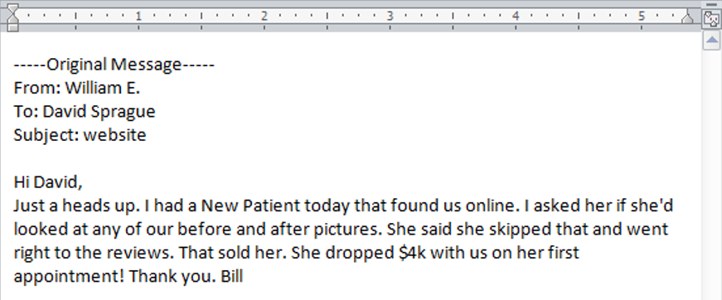
Marketing Game Changer
Proof: Reviews Send You Hot, Prequalified Leads
Because Buyers Trust Reviews…

Slide 10
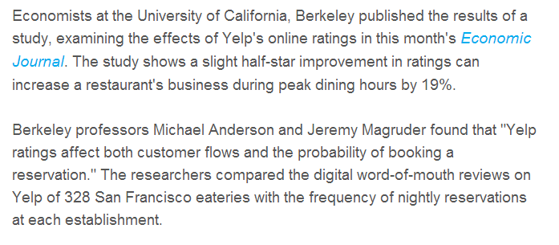
Reputation Marketing
“Reputation Marketing Has Proven To Increase Business By 19% By Increasing ½ Star Rating Online”

Slide 11
Definition Of Reputation Marketing:
Wikipedia: The “Reputation Marketing” field has evolved from the marriage of the fields of Reputation Management and Brand Marketing.
Reputation
Management
Brand
Marketing
Reputation Marketing: Building A Five Star Reputation, And Then Market Your Reputation To Get More Customers.

Slide 12
Let’s Show You How We Have Cracked The Code With…
“Reputation Marketing” And [In Beta] Expose Interview Commercials

Slide 13
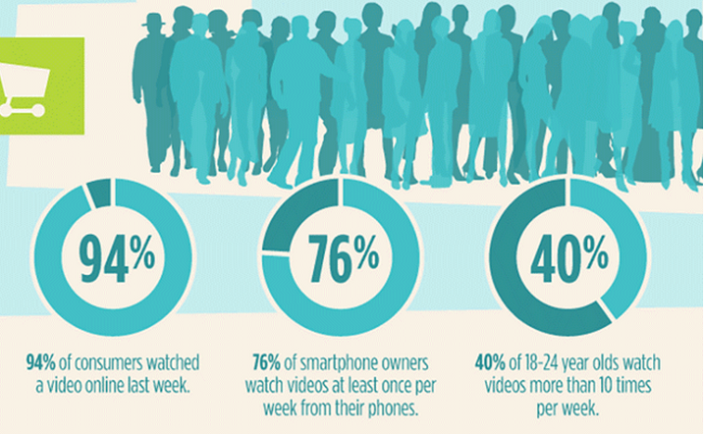
Why Video Marketing
- Positions You As A Market Leader
- Social Media And SEO Value - It’s A Long Term Asset Of The Company

Slide 14
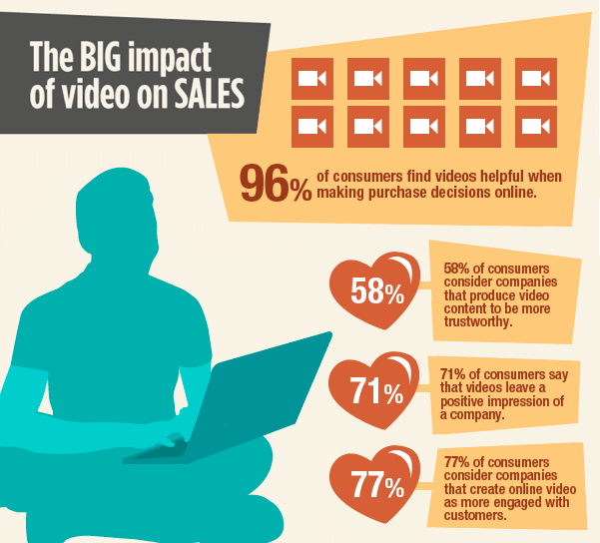
Video Marketing Stats

Slide 15
Your Reputation Consists Of:
Your Reviews Online
Your Customers Experience
3) Your Expertise In The Marketplace
What Can Customers Find Online That Positions Shows Your Personal Expertise In The Marketplace?

Slide 16
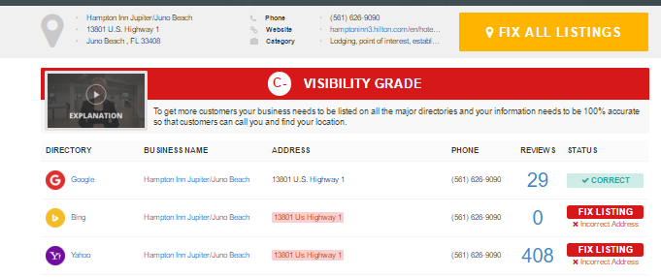
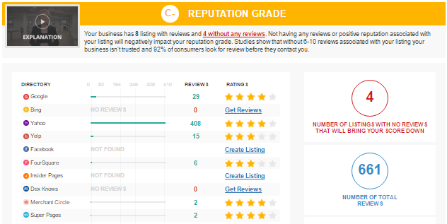
Lets Take A Look
Pull Your Reputation Report

Slide 17
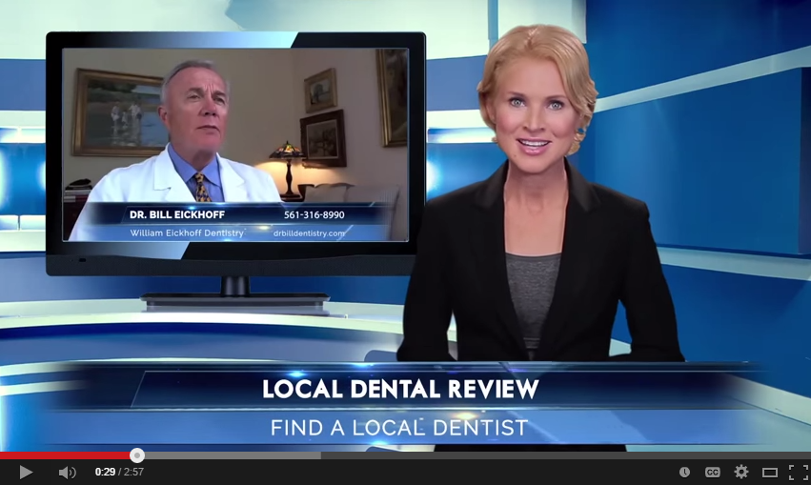
Two Strategies
Combine Into One
Reputation
Video
Marketing
Expert Interview Launch $1500
Marketing

Slide 18
Our Beta Program Can Position You As The Market Leader. All We Need Is
Confirm Company Name Spelling
Confirm Phone Number
Confirm Website URL
Photo Of The Expert
Review Script Outline
Record Audio Interview
YouTube Account For Broadcasting
Confirm Technical Sign Off Date
3 Referrals Of Other Businesses
Feedback On Your Experience
Cover Our Syndication Costs

Slide 19
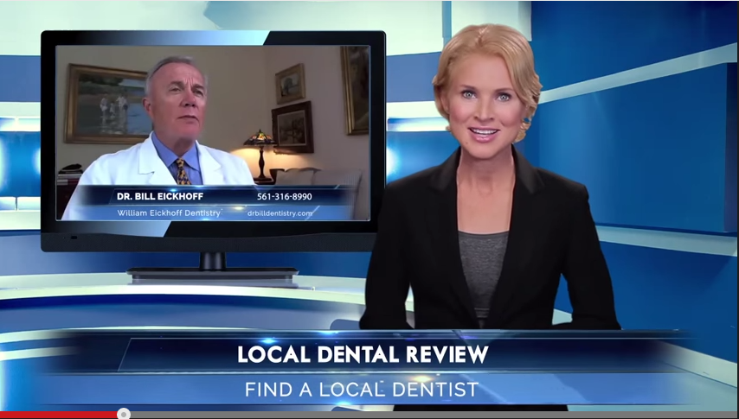
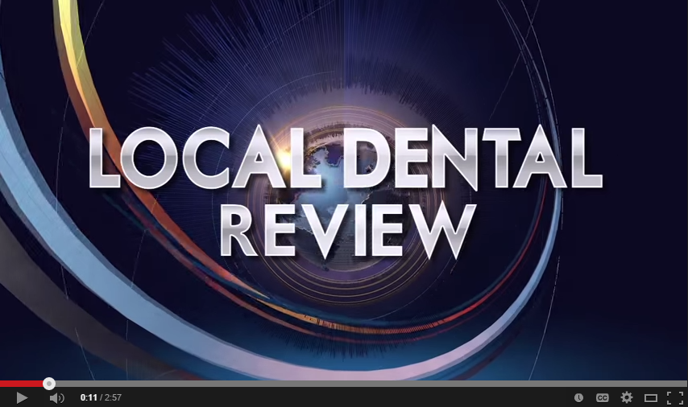
Welcome To Our “Expose Interview” Beta
“Videos That Market Your Expertise”
“Expert Interview”
100% Original And Unique Video
- Hosted By Professional Spokes Model
Shot In Hollywood Style Studios
- Prime Time Graphics And Animation
Call To Action Close
Perfectly SEO Optimized
Video Share Broadcast
- Social Media Syndication - Facebook, LinkedIn, Google+ etc.
How Much Would It Cost To Produce An Interview Like This?

Slide 20
Welcome To Our “Review Commercial” Beta
What Would It Cost A Company To Create?
Hire A Professional Spokes Model $800.00 + Royalties
Stage A Hollywood Style Studio $750.00
Hire A Professional Videographer $500.00
Hire Make Up Artist $175.00
Hire A Video Editor $500.00
Hire Prime Time Graphics Animator $400.00 $3,125.00
Video Optimization $50
Video Broadcasting $200
Social Media Syndication $250
$ 500.00
$3,650.00

Slide 21
3
1
Brand Marketing $10,000’s
Problem
Problem
SEO Marketing $1000’s
Our $1,497 Program After Beta
Five
4
Video Marketing $10,000’s
5
Problem
Problem
2
Powerful REASONS
Problem
To Have Expert Interviews Every Month
Social Media Marketing $1000’s
Reputation Management $1000’s
Expert Interviews Help Solve All 5 Problems For A Fraction Of The Cost
Notes:
Attention!
Before you open this template be sure what you have the following fonts installed:
Novecento Sans wide font family (6 free weight)
http://typography.synthview.com
Abattis Cantarell
http://www.fontsquirrel.com/fonts/cantarell
Icon Sets Fonts:
raphaelicons-webfont.ttf from this page: http://icons.marekventur.de
iconic_stroke.ttf from this page: http://somerandomdude.com/work/open-iconic
modernpics.otf from this page: http://www.fontsquirrel.com/fonts/modern-pictograms
general_foundicons.ttf, social_foundicons.ttf, accessibility_foundicons.ttf from this page: http://www.zurb.com/playground/foundation-icons
fontawesome-webfont.ttf from this page: http://fortawesome.github.io/Font-Awesome
Entypo.otf from this page: http://www.fontsquirrel.com/fonts/entypo
sosa-regular-webfont.ttf from this page: http://tenbytwenty.com/?xxxx_posts=sosa
All fonts are permitted free use in commercial projects.
If you have difficulties to install those fonts or have no time to find all of them, please follow the FAQs:
http://graphicriver.net/item/six-template/3626243/support

Slide 22
Next Step: Technical Sign Off
We’ll go over the video and get your sign off and release and the details of the sites you want it syndicated on.
On the sign off we will also go over a Reputation Marketing strategy with you and get your feedback on the process.
Lets Confirm Technical Sign Off Meeting Date & Time

